Slide 1
Collections

Slide 2
Collections

Slide 3
List the classes/interfaces in Collection Framework
Distinguish and use concrete classes of List, Set and Queue interface
Distinguish and use concrete classes of Map interface
Understand Legacy classes in Collections API
Use Collections Utility class
Implement Comparable and Comparator Interface

Slide 4
Collections API

Slide 5
INTRODUCTION TO COLLECTIONS
Collection
represents a group of objects of similar type, known as its elements
provide flexibility to add or remove objects
provide capability to store objects in an ordered way
provide capability to prevent duplicate objects
provides capability to store objects with key-value pairing
Basic operations
Add objects
Remove objects
Search objects
Retrieve objects
Iterate

Slide 6
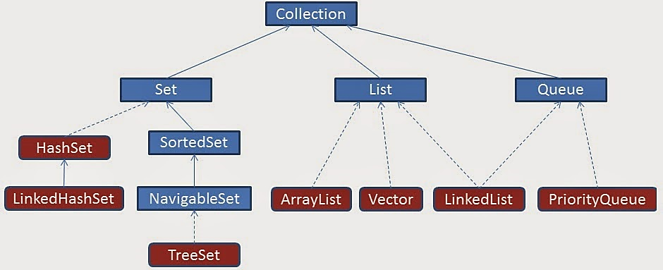
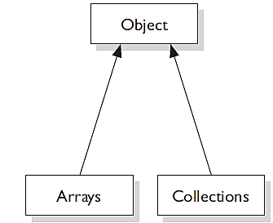
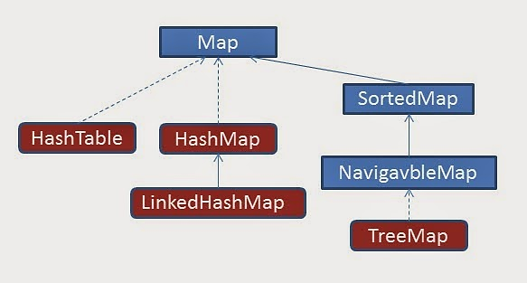
Collections Framework

Slide 7
COLLECTION INTERFACE
Root interface in Collection Hierarchy
Does not have any direct implementation
Extended by interface like List, Set and Queue
Collection framework classes/interface belong to java.util package
Key Methods :
add(element e) remove(Element o)
addAll(Collection c) removeAll(Collection c)
contains(Element o) isEmpty()
size() toArray()
iterator() clear()

Slide 8
LIST
an ordered collection (aka sequence)
orders objects based on the index
allows duplicate elements
precise control over where in the list each element is inserted
provides methods for positional (indexed) access of list elements
Key Methods :
get(int index) indexOf(Element o)
add(int index, Element o) remove(int Index)
lastIndexOf(Element o) listIterator()

Slide 9
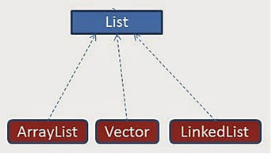
LIST CONCRETE IMPLEMENTATIONS
ArrayList
Dynamically growing Array (initial capacity 10)
Elements stored contiguously in memory
Methods of ArrayList are not synchronized
Features
Effecient iteration and random access
Insertion/Deletion of elements at specific indexes from a large list is expensive

Slide 10
LIST CONCRETE IMPLEMENTATIONS
Vector
Same as an ArrayList, but has synchronized methods for thread safety
Stack is a subclass of Vector that implements a standard last-in, first-out stack (LIFO).
Elements can retrieved, inserted, or removed from the top of the stack.
Methods of Stack :
+empty() : boolean
+peek() : Object
+pop() : Object
+push (element:Object) : void
+search (element:Object) : int

Slide 11
LIST CONCRETE IMPLEMENTATIONS
LinkedList
Elements are doubly-linked to one another
Each Node holds Data and Address of previous and next node
Features
Insertion/Deletion of elements is less expensive compared to ArrayList
Iteration over linked list is required, to retrieve any element
Gives extra methods for adding and removing elements from the beginning or end

Slide 12
DIFFERENCE BETWEEN ARRAYLIST AND VECTOR
ArrayList
Vector
ArrayList is not synchronized.
ArrayList increments 50%of current array size if number of element exceeds from its capacity.
ArrayList is faster as its methods are non-synchronized
ArrayList uses Iterator interface to traverse the elements
Vector is synchronized.
Vector increments 100% means doubles the array size if total number of element exceeds its capacity.
Vector is slow because its methods are synchronized
Vector uses Enumeration interface to traverse the elements. (can use Iterator also)

Slide 13
ARRAYLIST – BEFORE JAVA VERSION 5
ArrayList class as defined in Java API for holding objects before version 5
Public class ArrayList extends AbstractList implements List
public boolean add(Object o)
Appends the specified element to the end of this list
public Object get(int index)
Returns the element at the specified position in this list.
ArrayList myList = new ArrayList();

Slide 14
ARRAYLIST – BEFORE JAVA VERSION 5
import java.util.*;
class TestList{
public static void main(String[] args) {
Integer i1 = new Integer(10);
String s1 = "Hello";
ArrayList list = new ArrayList();
list.add(i1);
list.add(s1);
Object o1 = list.get(1);
String s2 = (String)o1;
System.out.println(s2.length());
}
}
DrawBacks
Any object can be added to the list
If the List is supposed to hold one particular type of object, it cant be restricted
The object retrieved from the list has to be casted back to required type before use
Type casting is unsafe

Slide 15
ARRAYLIST WITH GENERICS
Generics
Provides capability to parameterize Types
Helps define class or methods independent of data type
Diamond operator (<>) is used for type Inference
ArrayList class using Generics is defined in JAVA API as
E is Type parameter
Elements added to the List can be of only Type E or its subtypes
If the List is of Type String, Only Strings can be stored in the list
No Type casting required as compiler knows the type of object stored
Public class ArrayList<E> extends AbstractList<E> implements List<E>
public boolean add(E e)
Appends the specified element to the end of this list
public E get(int index)
Returns the element at the specified position in this list.
ArrayList<String> myList = new ArrayList<String>();
ArrayList<String> myList = new ArrayList<>(); // From Java ver 7

Slide 16
ARRAYLIST WITH GENERICS
DEMO
import java.util.*;
class TestList{
public static void main(String[] args) {
Integer i1 = new Integer(10);
String s1 = "Hello";
ArrayList<String> list = new ArrayList<String>();
//list.add(i1); - Compile Error
list.add(s1);
String s3 = list.get(1);
System.out.println(s3.length()); - No Casting required
}
}

Slide 17
ITERATOR INTERFACE
Enables traversing through a collection in forward direction
Remove elements from the collection selectively while iterating
The Iterator Interface has three methods
boolean hasNext() - Check the existense of next element
object next() - Retrieves next element
void remove() - Removes last element obtained using next() method
ListIterator -
An iterator for lists to traverse the list in either direction and modify the list during iteration
List<String> myList = new ArrayList<String>();
Iterator it = myList.iterator();

Slide 18
SORTING LISTS
Collections.sort() method is used to sort Lists of objects
A class must implement Comparable interface, so that objects its objects can be compared
Comparable interface has one method compareTo which must be overridden by the class for comparing objects
JVM calls the compareTo method automatically when objects need to be compared
Comparable interfaces provides the natural ordering of elements in a collection

Slide 19
SORTING LISTS
compareTo method defines the criteria for comparing objects. It takes object to be compared as parameter.
compareTo(T o)
The compareTo() method returns an int
negative thisObject < passedObject
zero thisObject == passedObject
positive thisObject > passedObject
class Employee implements Comparable<Employee> {
public int compareTo(Employee e1) {
return (this.empId - e1.empId);
} }

Slide 20
STACK
Stack<String> st = new Stack<String>();
st.push("a");
st.push("b");
st.push("c");
System.out.println(st.pop());
System.out.println(st.pop());
System.out.println(st.pop());

Slide 21
SET
Set is a Collection that cannot contain duplicate elements
Sets contain no pair of elements e1 and e2 such that e1.equals(e2)
Java platform contains three general-purpose Set implementations: HashSet, TreeSet and LinkedHashSet
SortedSet is a Set that provides a total ordering on its elements. The elements are ordered using their natural ordering

Slide 22
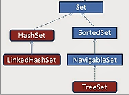
SET CONCRETE IMPLEMENTATIONS
HashSet
Unsorted, Unordered Set
Use when duplicates are not allowed and order is not important
LinkedHashSet
Ordered, Unsorted Set
HashSet that maintains a doubly-linked List across all elements
Use when duplicates are not allowed and order is important
TreeSet
Keeps the elements in Sorted Order
Elements will be in ascending order, according to natural order
Use when duplicates are not allowed and sorted order is important

Slide 23
SET CONCRETE IMPLEMENTATIONS
HashSet
Uses hashcode and equals() to prevent duplicates
Uses hashcode of object to insert and search elements
Elements of Hashset need to override hashCode() method and equals() method to provide object equality
TreeSet
Uses Comparable /Comparator for keeping the elements in sorted Order and checking the equality

Slide 24
WHAT SET TO CHOOSE AND WHEN
HashSet is a good choice for representing sets if element ordering is not important
if ordering is important, LinkedHashSet or TreeSet are better choices. However they come with an additional speed and space cost.
Iteration over a LinkedHashSet is generally faster than iteration over a HashSet.
Tree-based data structures get slower as the number of elements get larger.
Since TreeSet keeps its elements sorted, it can offer other features, such as the first and last methods, that is, the lowest and highest elements in a set, respectively.

Slide 25
QUEUE
Objects arranged in the order in which they are to be processed
Queues typically, but do not necessarily, order elements in a FIFO (first-in-first-out) manner
Besides basic Collection operations, queues provide additional insertion, extraction, and inspection operations
 | Throws exception | Returns special value
Insert | add(e) | offer(e)
Remove | remove() | poll()
Examine | element() | peek()
offer– used to add element to the tail of the Queue
poll – used to get elements from the head of the Queue
peek – used to review the element at the head of the Queue

Slide 26

QUEUE CONCRETE IMPLEMENTATIONS
LinkedList
First in First out
Priority Queue
Stores element based on priority set by the Comparable/Comparator
Queue<String> myQueue = new LinkedList<String>();
myQueue.offer(“first”);
PriorityQueue<String> myQueue = new PriorityQueue<String>();
myQueue.offer(“first”);

Slide 27
MAP
An object maps a unique key to a specific value, where key and value are objects
Elements of Map are stored as key-value pair
map cannot contain duplicate keys
Allows to
Search for a value based on the key
Get a collection of just Keys using keySet method
Get a collection of just values using values method
Key Methods :
put(Key k, Value v) get(Key)
remove(Key ) keySet()
values()

Slide 28

MAP CONCRETE IMPLEMENTATIONS
HashMap
Unsorted, Unordered Map
Relys on equals() and hashCode for equality of Keys
LinkedHashMap
Unsorted Map,Ordered on keys
Relys on equals() and hashCode for equality of Keys
TreeMap
Sorted based on Keys
Sorted using comparable or comparator

Slide 29
SORTING USING COMPARATOR
Comparator interface provides the alternate ordering to sort objects in a collection
Class implementing Comparator interface has to override compare method
Compare method is used to define the criteria of comparison between two objects
It takes two objects as parameter and returns an int
int compare(T o1, T o2)

Slide 30
ENUMERATION INTERFACE
Enumeration interface defines a way to traverse all the members of a collection of objects.
Enumeration is only used in legacy classes such as Vector and Properties, this interface has been superceded by Iterator
Methods
hasMoreElements()
Checks to see if there are more elements
Then returns a Boolean
nextElement()
Checks to see if there are more elements
If yes, then returns the next element as an object
If there aren’t any more elements when nextElement() is called, the runtime NoSuchElementExceptionwill be thrown.

Slide 31
Generics
Multiple Parameters
A class can use multiple type parameters
A generic can restrict the type of object that can be used as the parameter by using Bounded Types
UpperBound
ArrayList<? extends Employee> means ArrayList of any object of class which extends Employee class can be passed as argument to printName Method
LowerBound
ArrayList<? super Manager> means ArrayList of any object of class Manager and its supertypes can be passed as argument to printName
public class HashMap<K,V> extends AbstractMap<K,V> implements Map<K,V>{
public V put(K key, V value)
……}

Slide 32
Generics
Method declarations can be made generic even if the class doesn’t use generic types
Generic Interfaces
Generic Type parameter cannot be of primitive type
public static <T extends Employee> printName(T t){
System.out.println(t.name);
}
interface List<T>{
public void put(T element, int position);
public T get(int position);
}

Slide 33
Describe Collection Framework
Distinguish between various Collection Implementations
Use appropriate Collection implementations based on the need
Compare and Sort objects in a Collection

